Slide 1
DATA STORYINGTELLING & STATISTICAL VALIDATION
NAME :PREETHI R
ApexPlanet Data Analytics internship
TASK 4

Slide 2
PROJECT OBJECTIVE
CONTENT
Analyze sales performance using Power BI.
Identify business insights.
Support data-driven decision making.

Slide 3
DATASET OVERVIEW
CONTENT
Sales Data
Order Data
Product Category
City
Gender
Order Date
TOOLS USED:
MICROSOFT EXCEL
POER BI

Slide 4
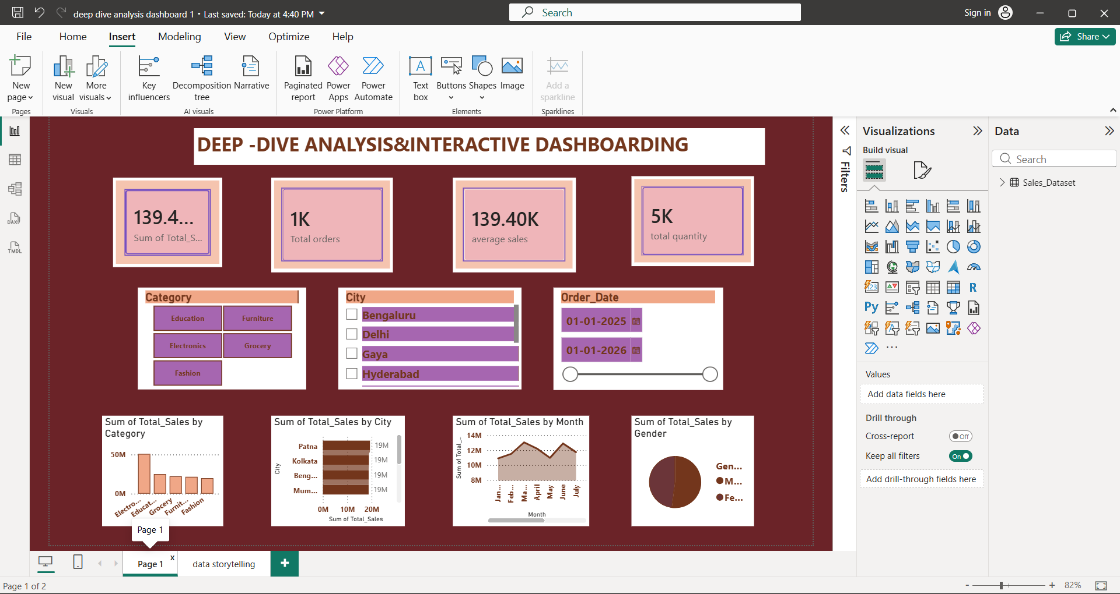
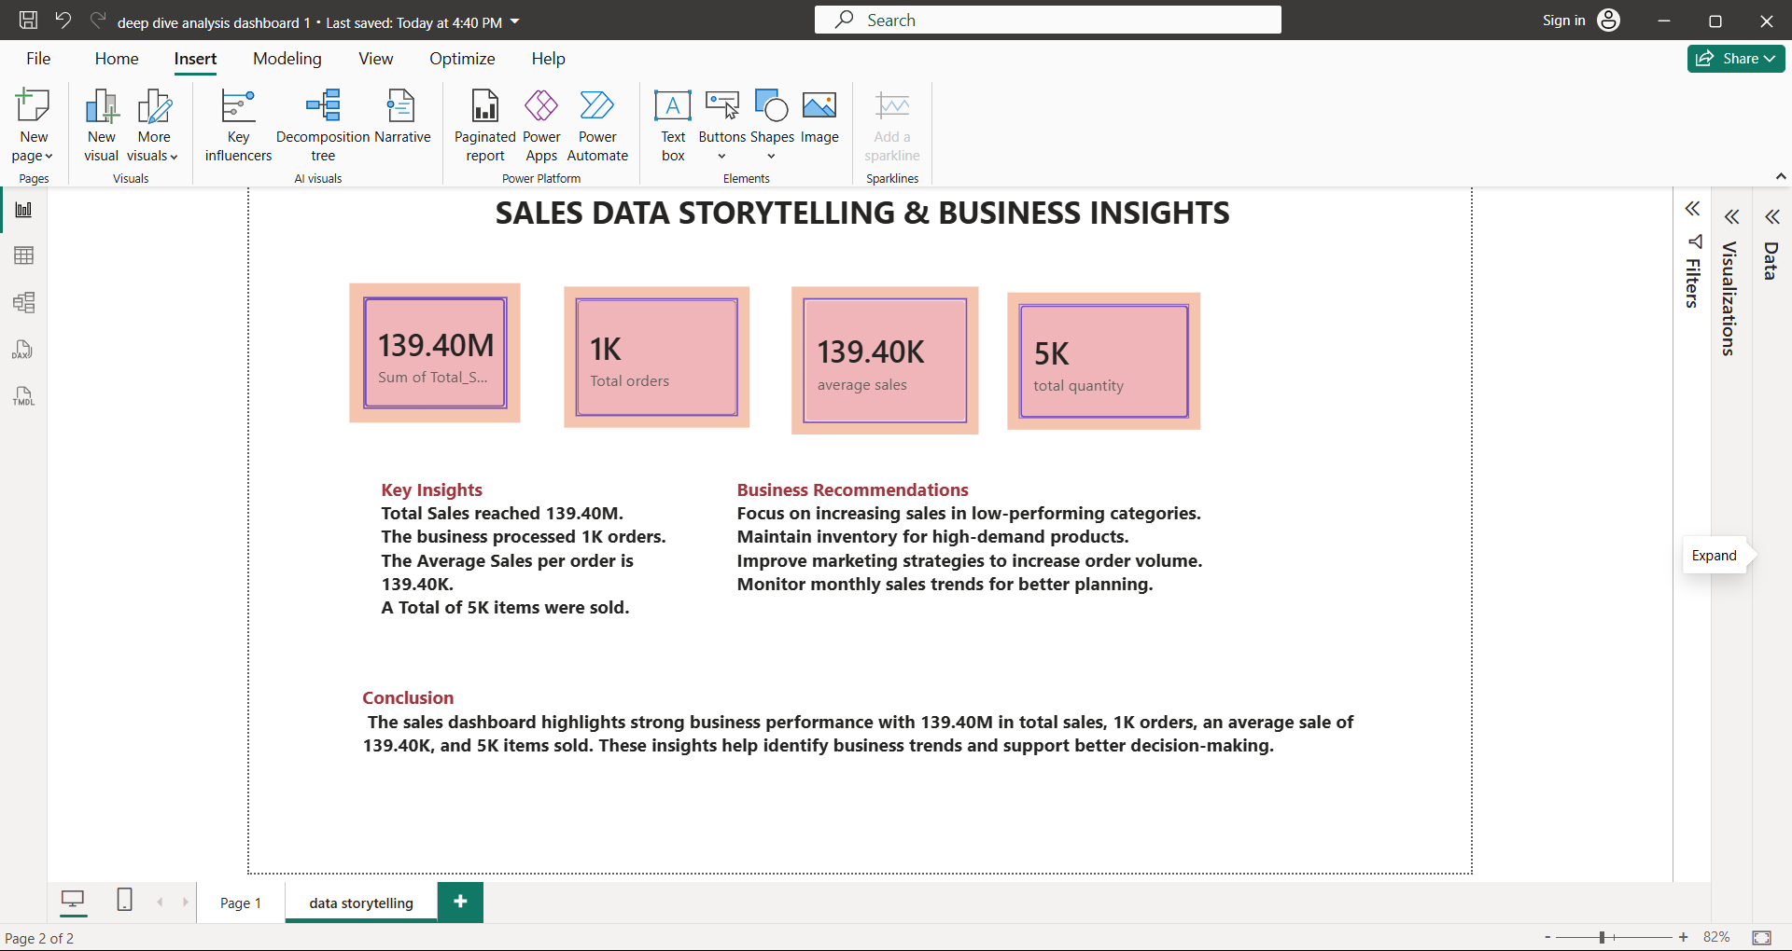
POWER BI DASHBOARD

Slide 5
KEY INSIGHTS
Total Sales: 139.40M
Total Orders: 1K
Average Sales: 139.40K
Total Quantity: 5K

Slide 6
BUSINESS RECOMMENDATION
Improve sales in low-performing categories.
Maintain inventory for high-demand products.
Increase marketing efforts.
Monitor monthly sales trends.

Slide 7
STATISTICAL VALIDATION
Null Hypothesis (H₀): There is no significant difference in total sales among product categories.
Alternative Hypothesis (H₁): There is a significant difference in total sales among product categories.
Conclusion: Sales vary across product categories, suggesting category influences sales performance.

Slide 8
CONCLUSION
The Power BI dashboard provided valuable insights into sales performance. The analysis helps businesses understand trends, improve decision-making, and focus on increasing sales and profitability.

